Slide 1
Lab: Processing Logs by Using Amazon EMR
Made for Professor Lanham A. by Amrit Singh

Slide 2
AGENDA
Accessing the AWS management console
Task 1: Launching an Amazon EMR cluster
Task 2: Connecting to the Hadoop main node by using SSH
Task 3: Running Hive interactively
Task 4: Creating tables out of source data by using Hive
Task 5: Joining tables by using Hive
Task 6: Querying the resulting dataset

Slide 3
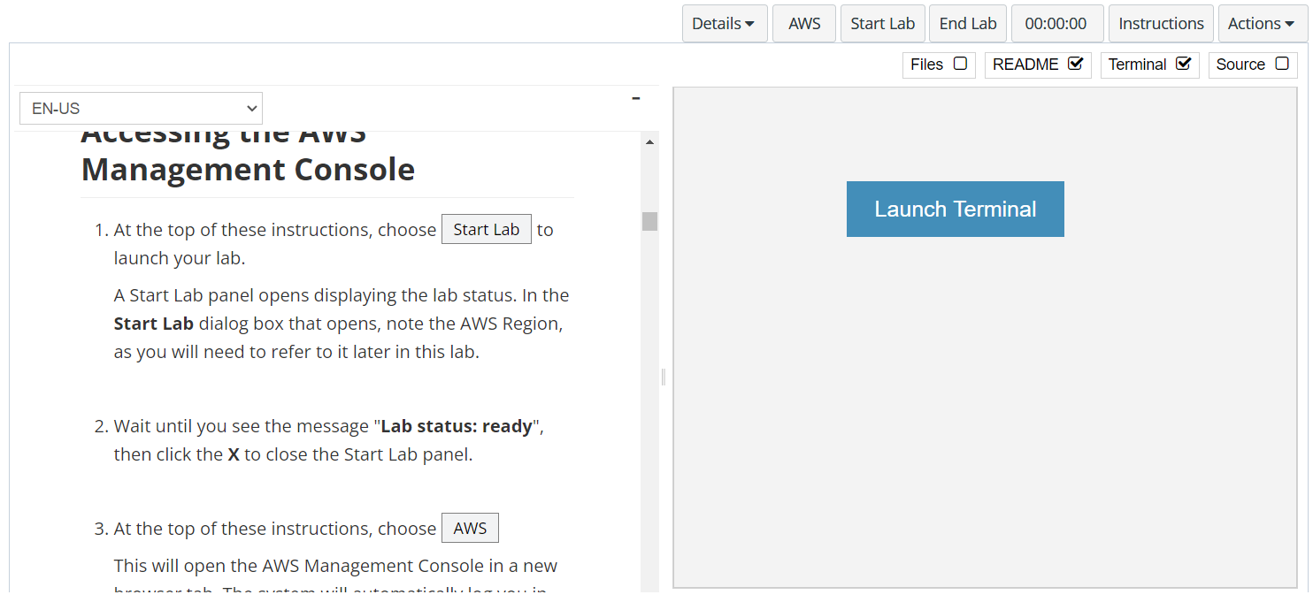
In aws labs click on start lab

Slide 4
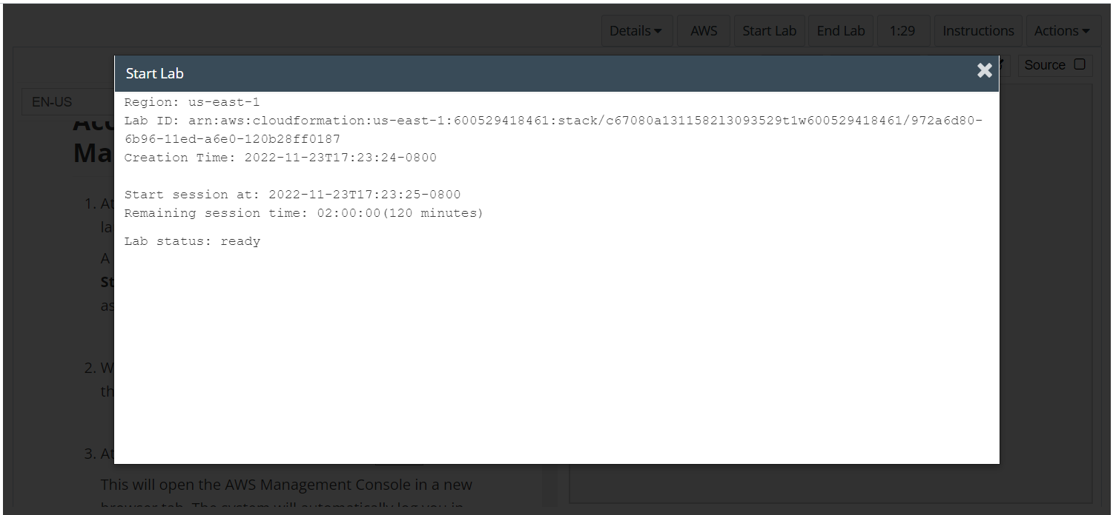
Wait to see lab ready status in the window then press x and click on aws to launch console

Slide 5
Task 1: Launching an Amazon EMR cluster

Slide 6
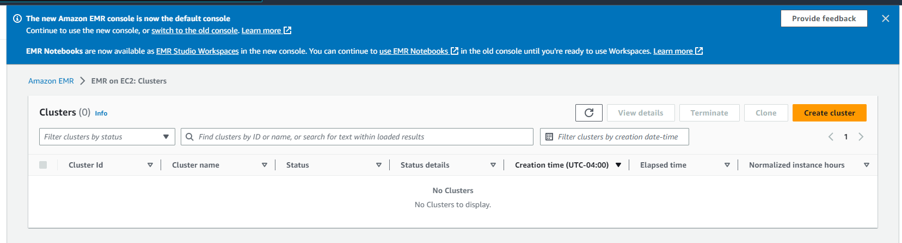
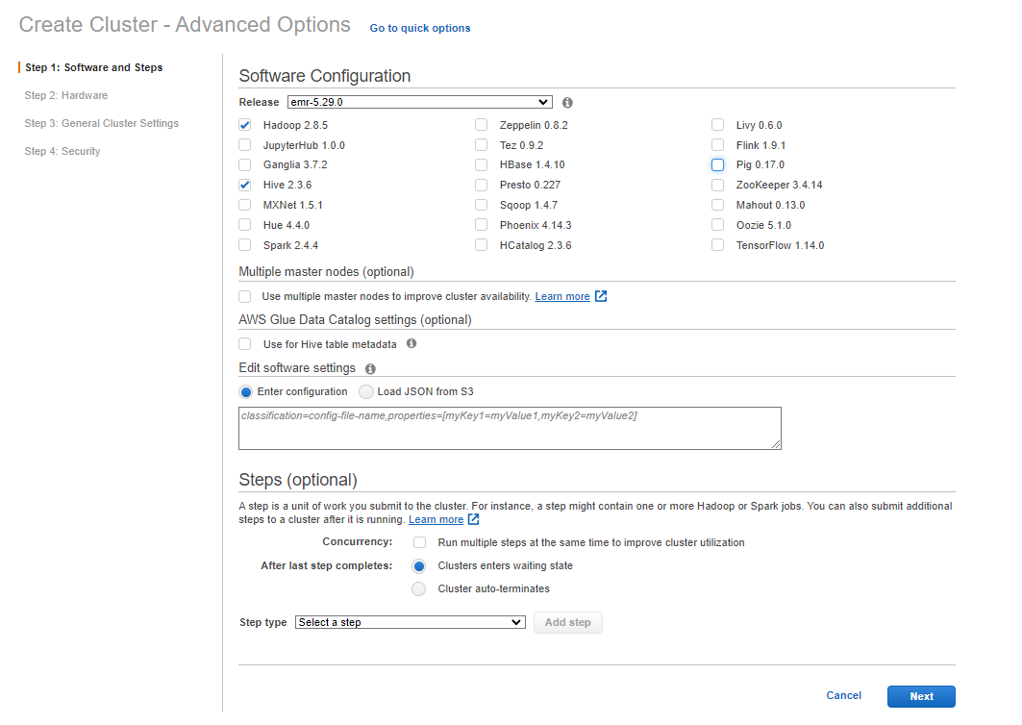
Open the emr console
To access the EMR console, in the search box to the right of Services, search for and choose EMR.
Launch the process to create an EMR cluster.
Choose Create cluster.
At the top of the page, to the right of Create Cluster - Quick Options, choose Go to advanced options.
Configure the options for Step 1: Software and Steps.
In the Software Configuration section, for Release, choose emr-5.29.0.
Ensure these applications are selected:
Hadoop 2.8.5
Hive 2.3.6
Clear (deselect) all other selected applications (for example, Hue and Pig).
Keep the other default settings, and choose Next.

Slide 7
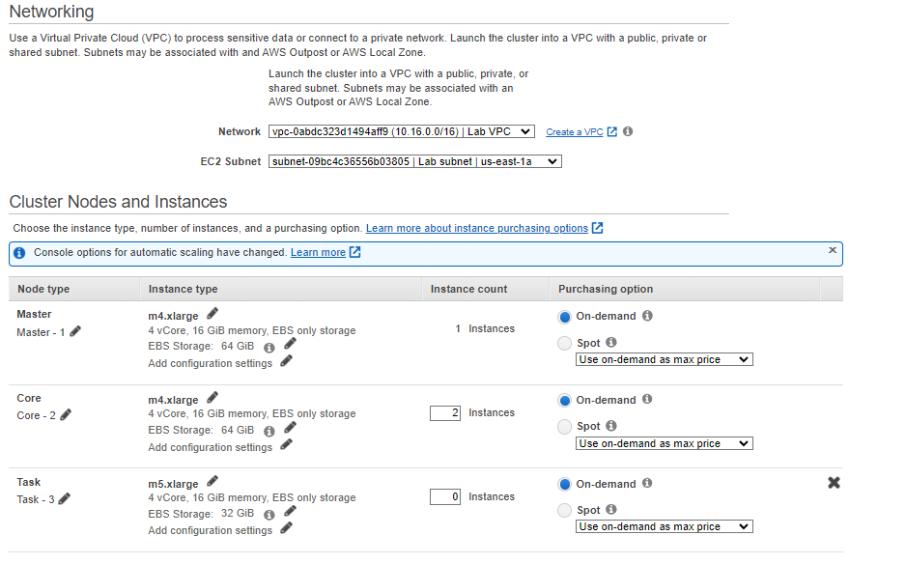
Configuring emr cluster
Configure the options for Step 2: Hardware.
In the Networking section:
For Network, choose Lab VPC.
For EC2 Subnet, choose Lab subnet.
In the Cluster Nodes and Instances section, set the instance type and number of nodes to use:
For the main node type, choose the pencil icon next to the instance type. Choose m4.large from the list, and then choose Save.
Repeat the same process for the Core node type.
Verify that the instance counts are as follows for each node type: 1 for main, 2 for core, and 0 for task.
Keep the other default settings, and choose Next

Slide 8
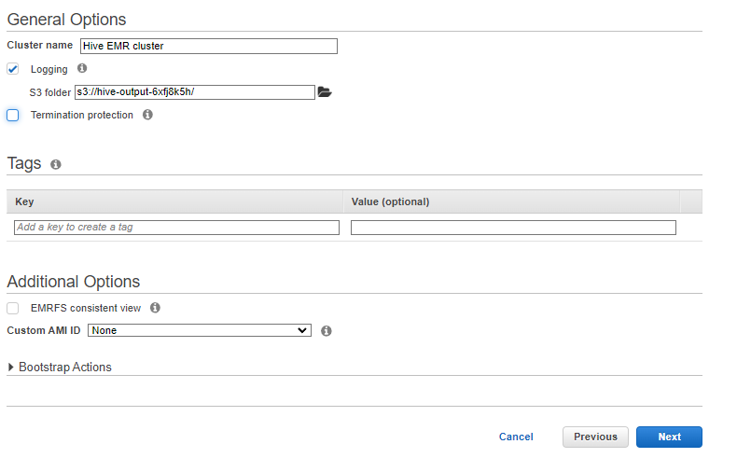
Configuring emr cluster
Configure the options for Step 3: General Cluster Settings.
For Cluster name, enter Hive EMR cluster
Ensure that Logging is selected.
For S3 folder, choose the folder icon, and select the S3 bucket for Hive output that was created for you. The bucket name has the format s3://hive-output-xxxxxx/ (where xxxxxx is a unique string). Choose Select.
Clear (deselect) the Debugging and Termination protection options.
Keep the other default settings, and choose Next.
Configure the options for Step 4: Security.
For EC2 key pair, choose the vockey key pair, which already exists in this account.
Note: You will download this key pair as labsuser.pem later in this lab. Vockey and labsuser.pem are the same key pair.
For Permissions, choose Custom.
For EMR role, confirm that EMR_DefaultRole is chosen.
For EC2 instance profile, confirm that EMR_EC2_DefaultRole is chosen.
For Auto Scaling Role, choose Proceed without role.
Expand the EC2 Security groups section. Observe that Amazon EMR will create one security group for the main node and another security group for the core and task nodes. Keep these default settings.
To finish creating the cluster, choose Create cluster.

Slide 9
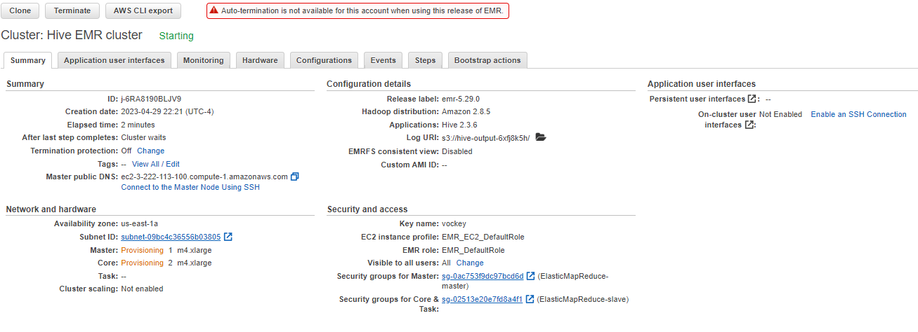
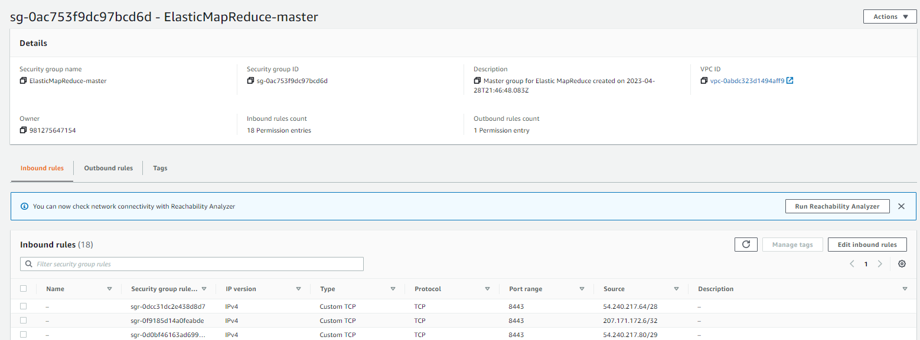
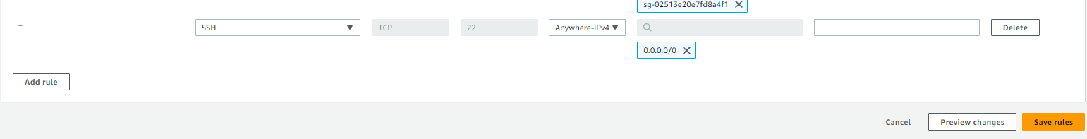
CONFIGURE SECURITY GROUP FOR ide
Configure the security group for the main node to allow SSH connections from the AWS Cloud9 instance.
While you are on the cluster's Summary tab, go to the Security and access section.
Next to Security groups for the main node, choose the link for the security group. If you don't see the link yet, refresh the page. It might take a minute or two to appear.
A new tab opens to the Security Groups page in the Amazon EC2 console.
Select the security group for the main node.
In the bottom pane, choose the Inbound rules tab, and then choose Edit inbound rules.
At the bottom of the page, choose Add rule, and then configure SSH access for the AWS Cloud9 instance that has been created for you:
Type: Choose SSH.
Source: Choose Anywhere-IPv4.
Choose Save rules.

Slide 10
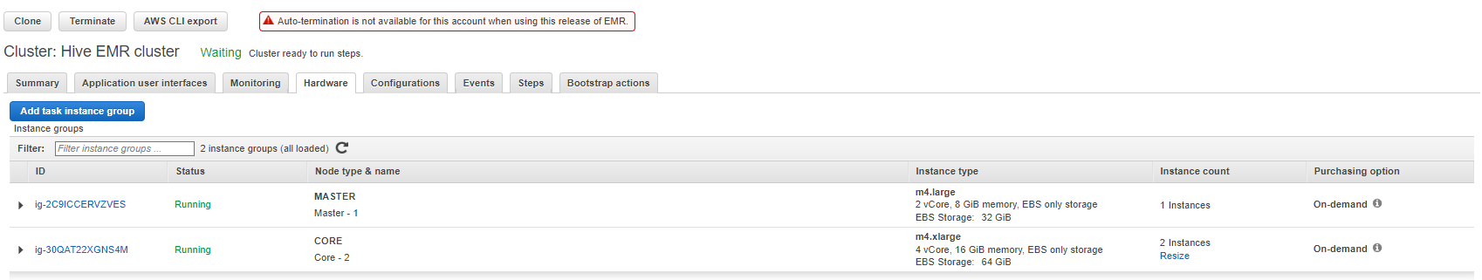
Confirm that the cluster is available
Confirm that the cluster is now available.
Return to the Amazon EMR console, which should still be open in another browser tab.
Refresh the page.
In the Network and hardware section, verify that the status for the main and core node types is Running.

Slide 11
Task 2: Connecting to the Hadoop main node by using SSH

Slide 12
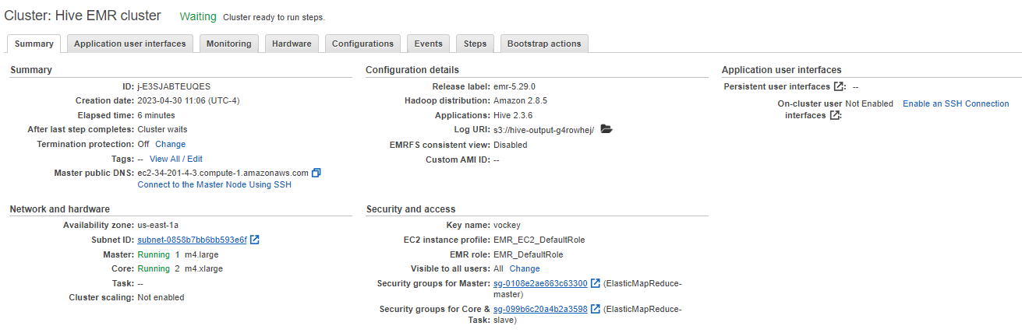
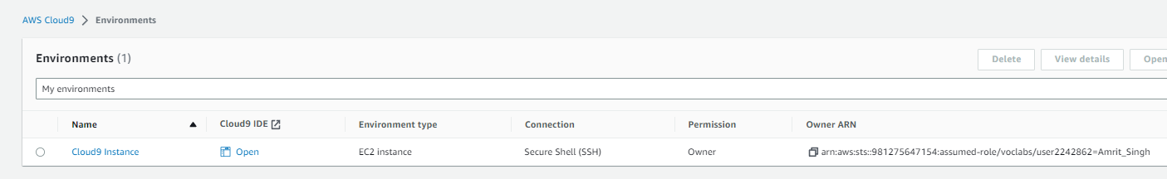
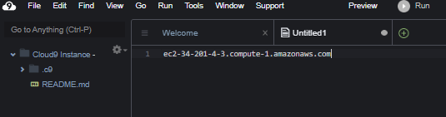
Copy the value of the public dns for emr
On the cluster Summary tab, in the Summary section, find the public DNS address for the main node. Copy the value to your clipboard.
Connect to the AWS Cloud9 IDE.
In the search box to the right of Services, search for and choose Cloud9 to open the AWS Cloud9 console.
For the Cloud9 Instance environment, choose Open IDE.
In the IDE, choose File > New File.
Paste the public DNS value from your clipboard into the file.
You will use this value soon.

Slide 13
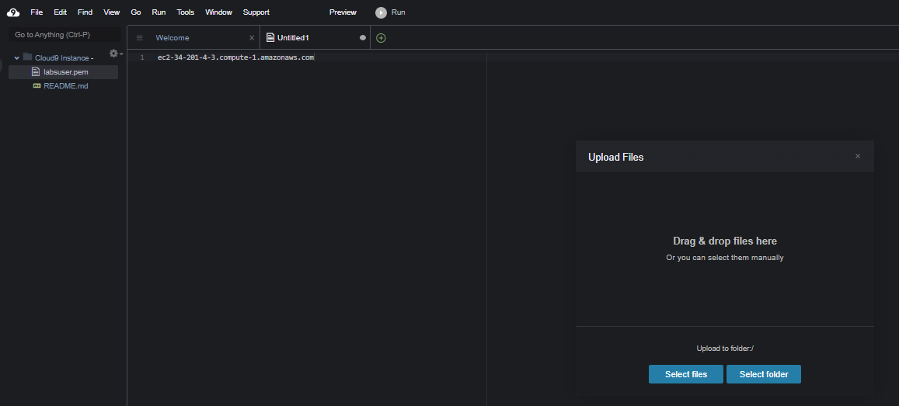
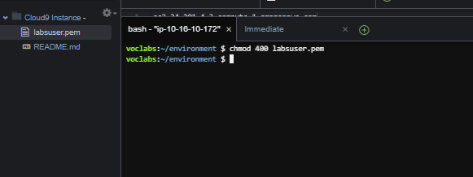
Upload the pem files to ide
Copy the SSH key to the AWS Cloud9 instance and configure it.
Above these lab instructions, choose AWS Details.
In the panel that opens, choose Download PEM and save the file to the directory of your choice.
Return to the AWS Cloud9 IDE.
Choose File > Upload Local Files....
Upload the labsuser.pem file into the AWS Cloud9 IDE.
Close the Upload Files dialog box.
Next, to modify the permissions on the key pair file so that the SSH software will allow you to use it, run the following command in the IDE terminal tab:
chmod 400 labsuser.pem

Slide 14
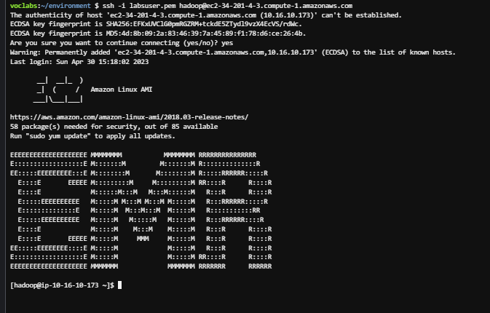
Establish ssh connection to the main node
Establish an SSH connection to the cluster's main node.
Run the following command. Replace with the public DNS address of the main node that you copied earlier.
ssh -i labsuser.pem hadoop@<PUBLIC-DNS>
When prompted whether to continue connecting, enter yes

Slide 15
Task 3: Running Hive interactively

Slide 16
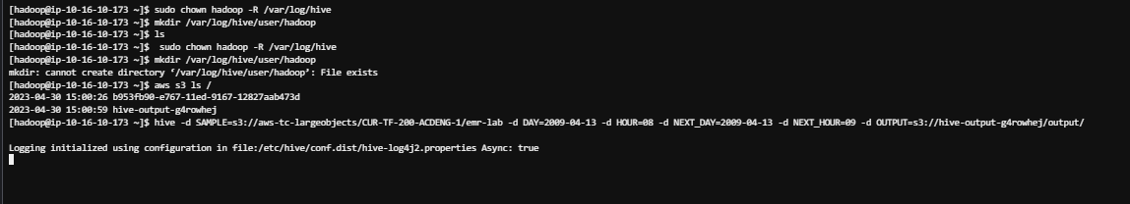
Connect to the redshift cluster and configure it to run the database
To create a logging directory for Hive, run the following commands:
Configure Hive.
To retrieve the name of the S3 bucket where you want to store Hive output, run the following command:
Run the following command. Replace with the full name for the hive-output bucket.
sudo chown hadoop -R /var/log/hive
mkdir /var/log/hive/user/hadoop
aws s3 ls /
hive -d SAMPLE=s3://aws-tc-largeobjects/CUR-TF-200-ACDENG-1/emr-lab -d DAY=2009-04-13 -d HOUR=08 -d NEXT_DAY=2009-04-13 -d NEXT_HOUR=09 -d OUTPUT=s3://<HIVE-BUCKET-NAME>/output/

Slide 17
Task 4: Creating tables out of source data by using Hive

Slide 18
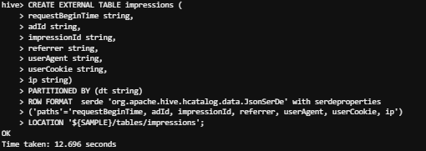
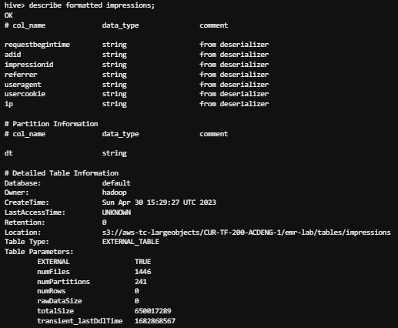
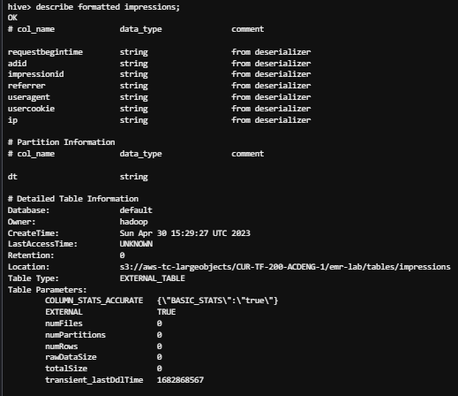
Configure the tables to store the source data
To create an external table named impressions, run the following code in the AWS Cloud9 terminal:
Update the Hive metadata for the impressions table to include all partitions.
To see how many partitions the impressions table currently has, run the following command:
To inspect the input data and apply partitions to the metastore, run the following command:
Run the following command again:
CREATE EXTERNAL TABLE impressions (
requestBeginTime string,adId string,impressionId string,referrer string,userAgent string,userCookie string,ip string)PARTITIONED BY (dt string)ROW FORMAT serde 'org.apache.hive.hcatalog.data.JsonSerDe' with serdeproperties('paths'='requestBeginTime, adId, impressionId, referrer, userAgent, userCookie, ip')LOCATION '${SAMPLE}/tables/impressions';
describe formatted impressions;
set hive.msck.path.validation=ignore;
MSCK REPAIR TABLE impressions;
describe formatted impressions;

Slide 19
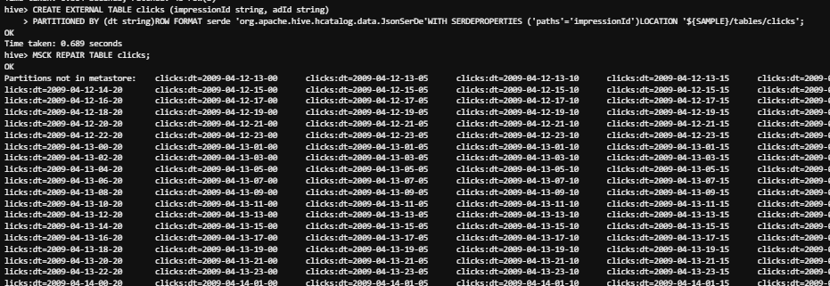

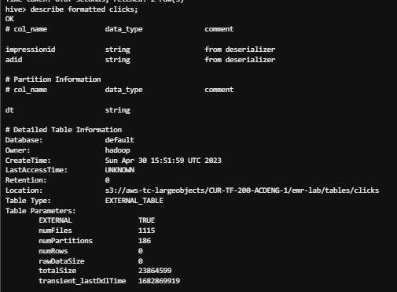
Configure the tables to store the source data
Create another external table and again discover its partitions. This table will be named clicks, and it references click-stream logs.
To create the table, run the following command:
To return all partitions from the click-stream log data, run the following command:
Verify that the two tables now exist.
Run the following command:
To describe the clicks table, run the following command:
CREATE EXTERNAL TABLE clicks (impressionId string, adId string)
PARTITIONED BY (dt string)ROW FORMAT serde 'org.apache.hive.hcatalog.data.JsonSerDe'WITH SERDEPROPERTIES ('paths'='impressionId')LOCATION '${SAMPLE}/tables/clicks';
MSCK REPAIR TABLE clicks;
show tables;
describe formatted clicks;

Slide 20
Task 5: Joining tables by using Hive

Slide 21
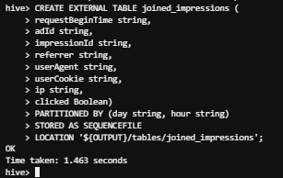
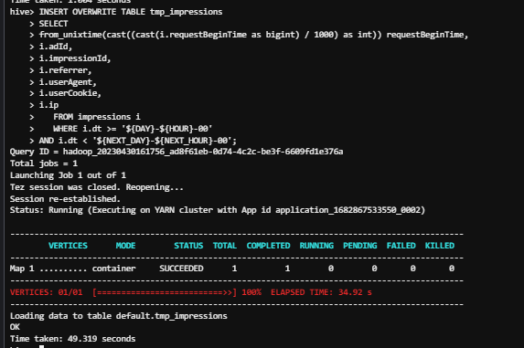
Create new external table for joining data
To create a new external table named joined_impressions, run the following command:
To create a new temporary table in HDFS named tmp_impressions to store intermediate data, run the following command:
To insert impression log data for the time duration referenced, run the following command:
CREATE EXTERNAL TABLE joined_impressions (
requestBeginTime string,adId string,impressionId string,referrer string,userAgent string,userCookie string,ip string,clicked Boolean)PARTITIONED BY (day string, hour string)STORED AS SEQUENCEFILELOCATION '${OUTPUT}/tables/joined_impressions';
CREATE TABLE tmp_impressions (
requestBeginTime string,adId string,impressionId string,referrer string,userAgent string,userCookie string,ip string)STORED AS SEQUENCEFILE;
INSERT OVERWRITE TABLE tmp_impressions
SELECTfrom_unixtime(cast((cast(i.requestBeginTime as bigint) / 1000) as int)) requestBeginTime,i.adId,i.impressionId,i.referrer,i.userAgent,i.userCookie,i.ip FROM impressions i WHERE i.dt >= '${DAY}-${HOUR}-00'AND i.dt < '${NEXT_DAY}-${NEXT_HOUR}-00';

Slide 22
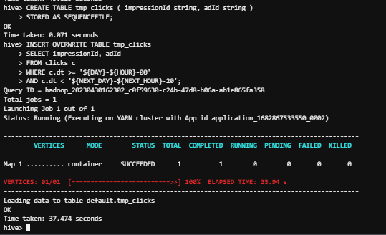
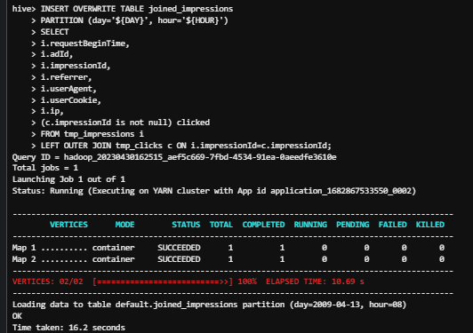
Create a temporary table and insert data and then join the tables
Create a temporary table named tmp_clicks and insert data into the table.
To create the table, run the following command:
To insert data into the tmp_clicks table, run the following command:
To create a left outer join of tmp_clicks and tmp_impressions that writes the resulting data set to the joined_impressions table in your S3 output bucket, run the following command:
CREATE TABLE tmp_clicks ( impressionId string, adId string )
STORED AS SEQUENCEFILE;
INSERT OVERWRITE TABLE tmp_clicks
SELECT impressionId, adIdFROM clicks cWHERE c.dt >= '${DAY}-${HOUR}-00'AND c.dt < '${NEXT_DAY}-${NEXT_HOUR}-20';
INSERT OVERWRITE TABLE joined_impressions
PARTITION (day='${DAY}', hour='${HOUR}')SELECTi.requestBeginTime,i.adId,i.impressionId,i.referrer,i.userAgent,i.userCookie,i.ip,(c.impressionId is not null) clickedFROM tmp_impressions iLEFT OUTER JOIN tmp_clicks c ON i.impressionId=c.impressionId;

Slide 23
Task 6: Querying the resulting dataset

Slide 24
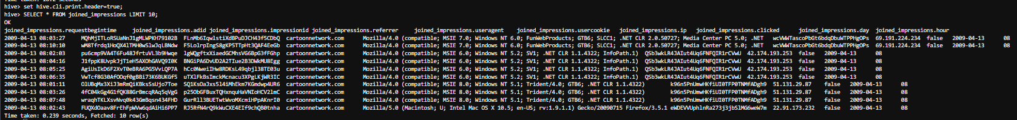
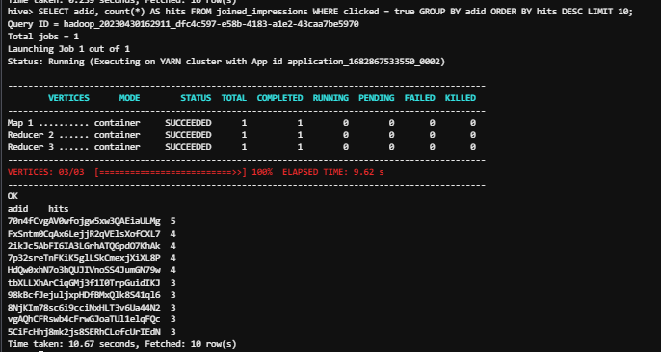
Go to cloud9 and perform the following queries
Use SQL-like queries to query the resulting dataset.
To instruct the HiveSQL client to print the names of the columns as headers in result sets, run the following command:
To return the first 10 rows of data in the joined_impressions table, run the following SELECT command:
Now run a more interesting query.
To exit the Hive CLI, run the following command:
exit;
set hive.cli.print.header=true;
SELECT * FROM joined_impressions LIMIT 10;
SELECT adid, count(*) AS hits FROM joined_impressions WHERE clicked = true GROUP BY adid ORDER BY hits DESC LIMIT 10;

Slide 25
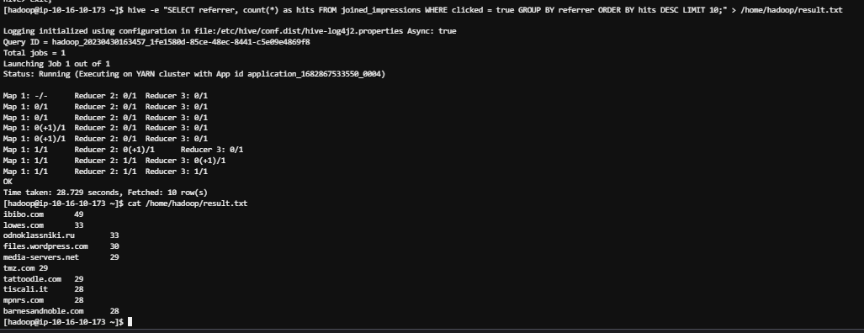
Continue running the sql queries
Continue running SQL queries against the data set.
Next, run the following command:
When the previous command completes, run the following command to read the results:
To exit the SSH session, run the following command:
hive -e "SELECT referrer, count(*) as hits FROM joined_impressions WHERE clicked = true GROUP BY referrer ORDER BY hits DESC LIMIT 10;" > /home/hadoop/result.txt
cat /home/hadoop/result.txt
exit

Slide 26
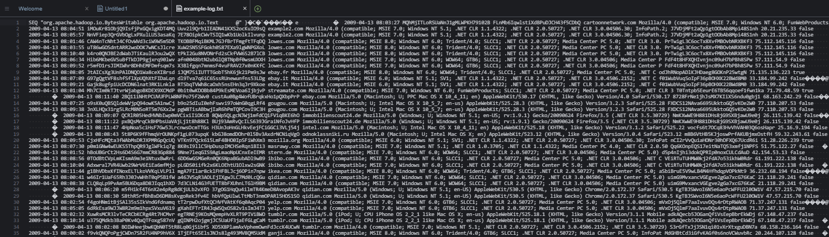
Analyze the log files
Analyze one of the log files that makes up the output from Amazon S3.
To rediscover the name of the bucket that contains the joined_impressions table data, run the following command:
Next, to download the file that contains the data that you have been querying, run the following command (be sure to replace <bucket-name> with the actual hive-output bucket name):
aws s3 ls /
aws s3 cp s3://<bucket-name>/output/tables/joined_impressions/day=2009-04-13/hour=08/000000_0 example-log.txt

Slide 27
Task 7: Reviewing the IAM policy for Amazon Redshift access

Slide 28
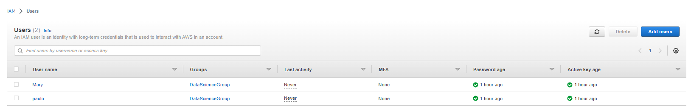
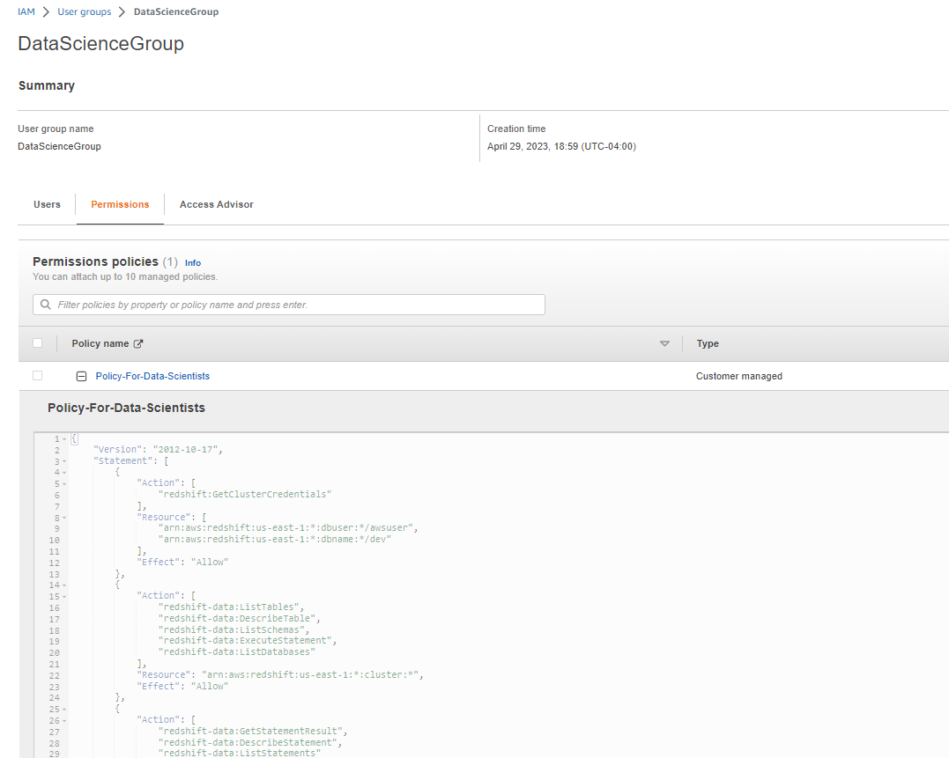
Analyze the iam policy created for you
Review the Policy-For-Data-Scientists IAM policy, which was created for you.
Navigate to the IAM console.
In the navigation pane, choose Users.
Notice the Mary user that is listed. This user is part of the DataScienceGroup IAM group.
Choose the link for the DataScienceGroup IAM group.
Choose the Permissions tab.
The policy that is attached to this group is displayed.
Choose the link for the Policy-For-Data-Scientists policy.

Slide 29
Task 8: Confirming that users can run queries on the Redshift database

Slide 30
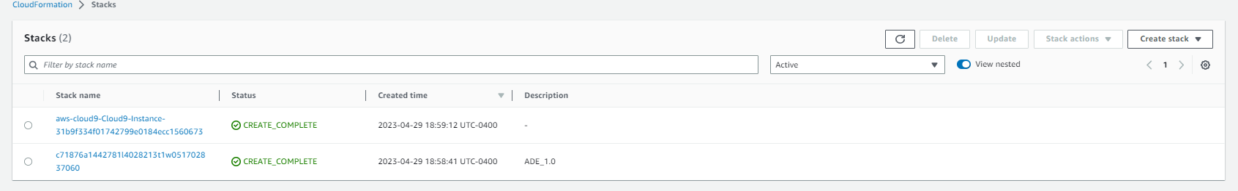
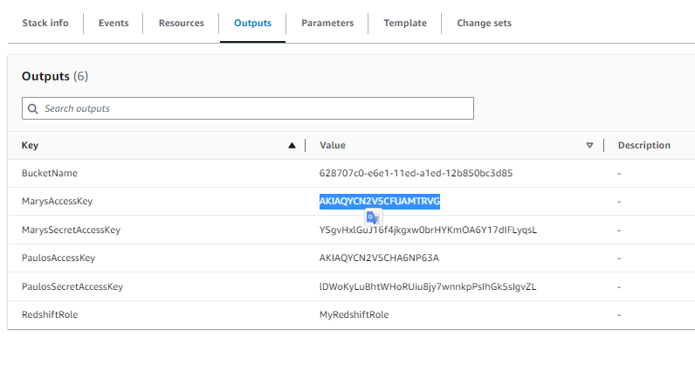

COPY MARY’S ACCESS AND SECRET KEYS AND PASS TO ide
Retrieve the credentials for the Mary IAM user, and store these as bash variables.
In the search box next to Services, search for and choose CloudFormation.
In the navigation pane, choose Stacks.
Choose the link for the stack that created the lab environment. The stack name includes a random string of letters and numbers, and the stack should have the oldest creation time.
On the stack details page, choose the Outputs tab.
Copy the value of MarysAccessKey to your clipboard.
Return to the AWS Cloud9 terminal.
To create a variable for the access key, run the following command. Replace <ACCESS-KEY> with the value from your clipboard.
AK=<ACCESS-KEY>
Return to the CloudFormation console, and copy the value of MarysSecretAccessKey to your clipboard.
Return to the AWS Cloud9 terminal.
To create a variable for the secret access key, run the following command. Replace <SECRET-ACCESS-KEY> with the value from your clipboard.
SAK=<SECRET-ACCESS-KEY>

Slide 31
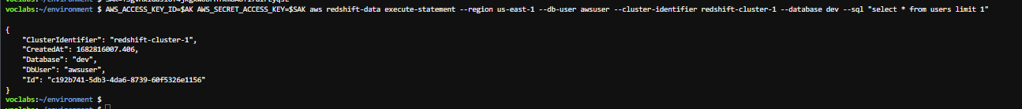
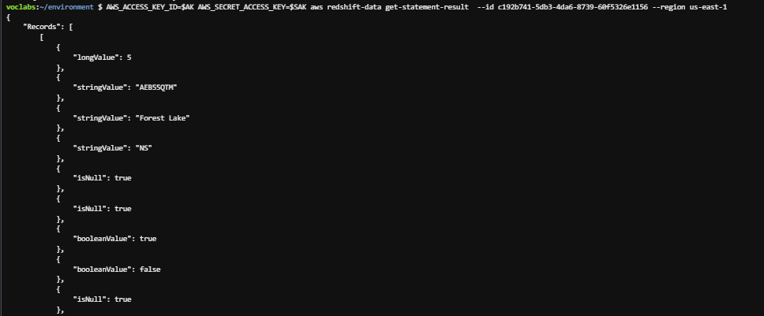
Analyze the iam policy created for you
Use the execute-statement command in the Redshift Data API to query the database.
Run the following command in the AWS Cloud9 terminal.
To retrieve the query results, copy the following command, replace the placeholder with the Id in the response above, then run the command in the terminal:
AWS_ACCESS_KEY_ID=$AK AWS_SECRET_ACCESS_KEY=$SAK aws redshift-data execute-statement --region us-east-1 --db-user awsuser --cluster-identifier redshift-cluster-1 --database dev --sql "select * from users limit 1"
AWS_ACCESS_KEY_ID=$AK AWS_SECRET_ACCESS_KEY=$SAK aws redshift-data get-statement-result --id <QUERY-ID> --region us-east-1

Slide 32
THANK YOU
Amrit Singh

